Slide 1
MAIN ENGINE EXHAUST VALVE OVERHAUL

Slide 2
1. PROBLEMS IN EXHAUST VALVE
1.1. COMMON PLOBLEMS
High temperature corrosion of complete valve and valve seat.
Reduction in the valve lift.
Failure of spring.
Erosion of valve and valve seat.

Slide 3
5. Bending of valve spindle.
6. Localised burning of valve and valve seat.
7. Breakage of valve rotator vanes.
8. Carbon or molten salt deposits in the exhaust passage and valve surface.
9. Poor cooling of valve cage.
10. Reseating failure leading to exhaust leakage.
11. Banging of valve while closing.

Slide 4
1.2. KNOCKING
One of the most common problems in exhaust valves is knocking while running. Following are some main reasons for the same –
Deficiency in the Oil System:
The knocking can be due to problems arising in the hydraulic oil system which is responsible for the operation of the valve:
Air in oil or air being drawn at pump suction side.
Supply pressure of oil is too low.
Oil temperature is high leading to reduction is viscosity.

Slide 5
II. Deficiency in the air system:
Incorrect Spring air supply pressure.
Defective or malfunctioning drain valve in the air chamber.
Defective or malfunctioning of safety valve in the air chamber.

Slide 6
III. Leakage in height pressure oil system:
Wrongly adjusted or defective throttle screw.
Oil cylinder piston ring in the exhaust valve leaking.
Oil cylinder safety valve on cam side leaking.
High pressure pipe is damaged.
Leakage in vent valve at the top.

Slide 7
2. MAIN ENGINE EXHAUST VALVE OVERHAUL PROCEDURE
To overhaul the exhaust valve place the valve on a wooden platform.
Loosen the nuts to remove the safety strap and the oil cylinder.
Discard the O-rings from the air cylinder.
Remove the four screws from the flange on top of the air piston & take out the flange.
Release the safety valve from the air cylinder for the air to escape below the piston.
Use a tin hammer to loosen the air piston from the conical locking ring & remove the conical locking ring.

Slide 8
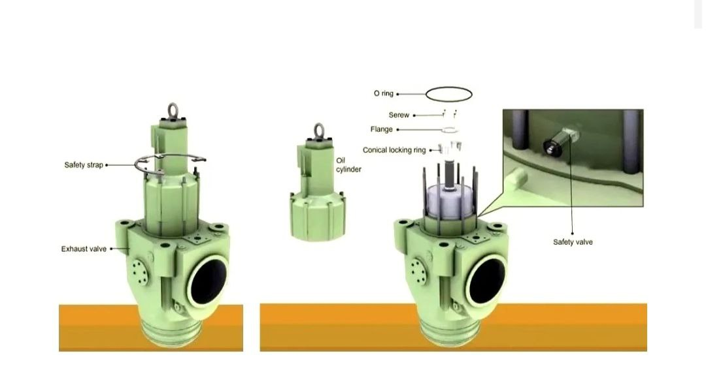

Slide 9
7. Lift the valve housing clear off the spindle.
8. Take out the air cylinder. Clean it and check the running surface for wear or possible scores. Measure the diameter of the air cylinder at four points diametrically opposite points using an inside micrometer.

Slide 10
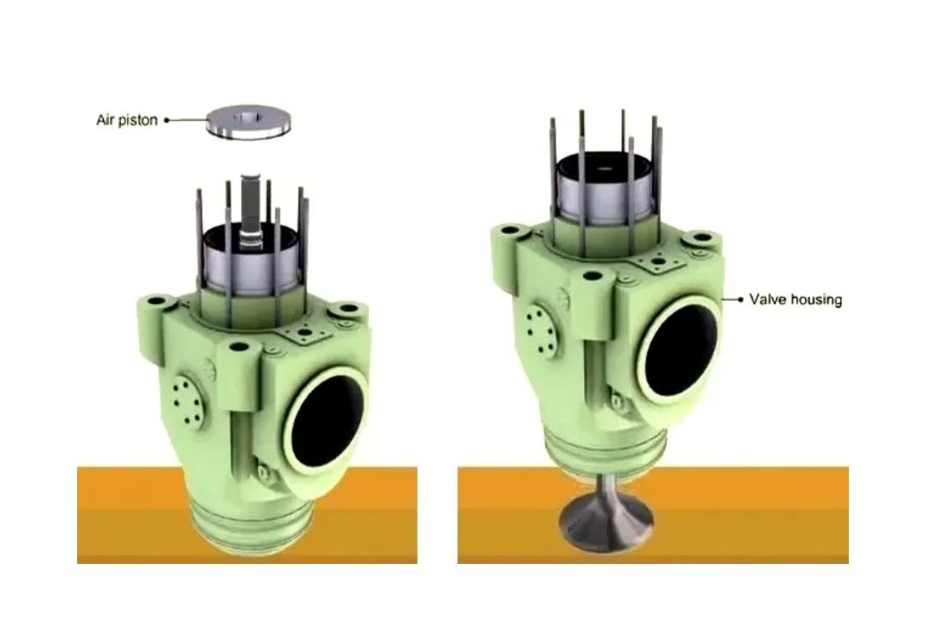

Slide 11
9. Remove the screws and dismount the flange of the stuffing box.
10. Remove and discard all the all the O-rings.
11. Inspect the bushing in the spindle guide for wear. Measure the inside diameter of the air cylinder using an inside micrometer. Maximum clearance should be 1mm in the top part and 2 mm in the lower part of the sleeve.

Slide 12
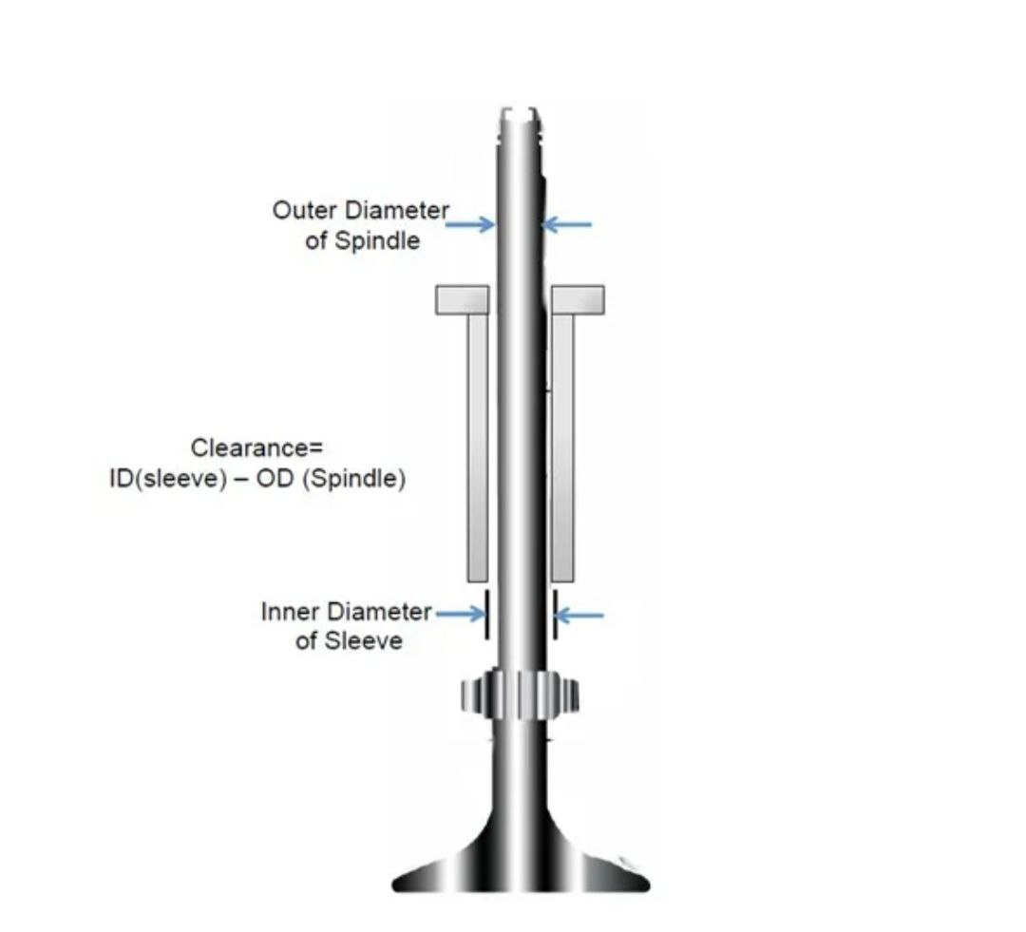

Slide 13
12. Unscrew and remove the lock screws which hold the bottom piece.
13. Lift the valve housing approximately 10mm above the ground.
14. With the help of a feeler gauge, check clearance between the valve and the seat. A 1mm feeler gauge should go up to 15 mm deep. This is to ensure that there is clearance between the outer parts of the seating faces of valve housing and spindle.

Slide 14
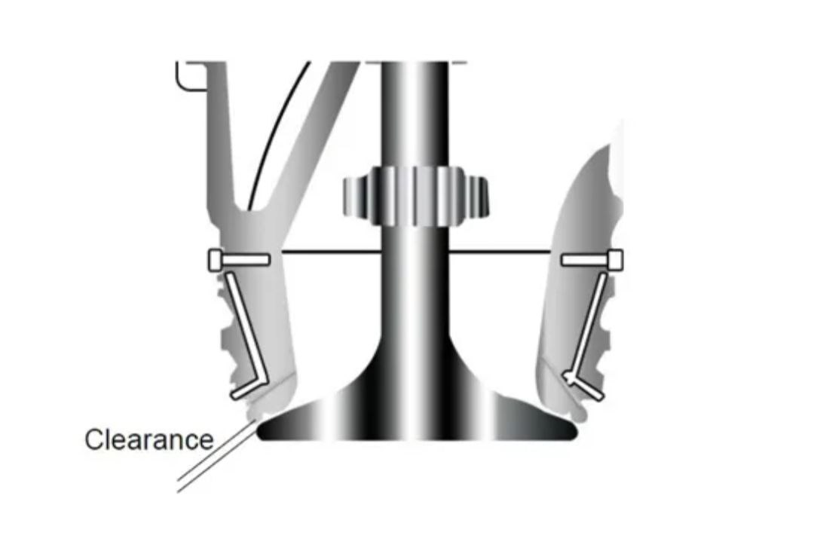

Slide 15
15. Now take out the valve seat using the tin hammer.
16. Lift the valve housing and place it on a couple of wooden planks.
17. Discard the O-ring from the groove on top of the valve seat.
18. Check for burnout marks in the valve face and seat.
19. Check for cracks and breakage of rotary vanes attached to the valve spindle.

Slide 16
20. Check scoring mark in the valve seat and valve face. This indicates valve rotator is not working and is leading to localised burning or leakage.
21. Inspect the seating of the bottom piece for damage with the template for damage measure the clearance G3 between the template and the O-ring groove using a feeler gauge.
22. Measure the clearance G2 between the template and the valve seat using a feeler gauge.
23. Take and record the measurements at four diametrically opposite points on the circumference of the valve spindle.

Slide 17
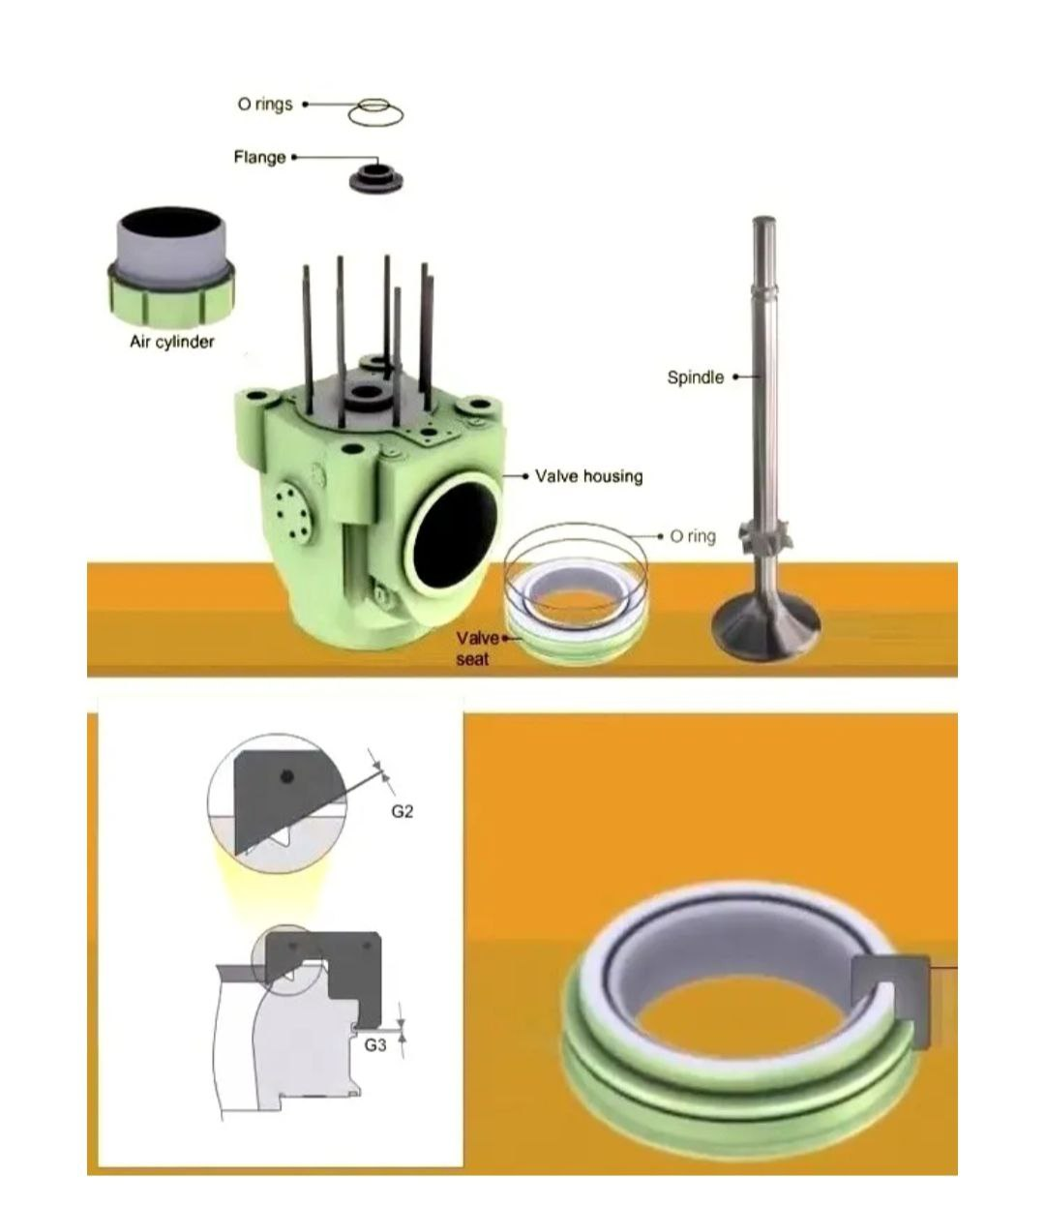

Slide 18
24. Clean the contact faces on the spindle & measure the gap between spindle template and seating of the spindle
25. Check the burn of F1 of the valve spindle at each of the points A, B, C, D & E. The notches in the spindle template indicate the points
26. Check the spindle stem for wear in the area between 460 mm and 620 mm measured from the top of the spindle take and record the measurements at four diametrically opposite points on the circumference of the valve spindle

Slide 19
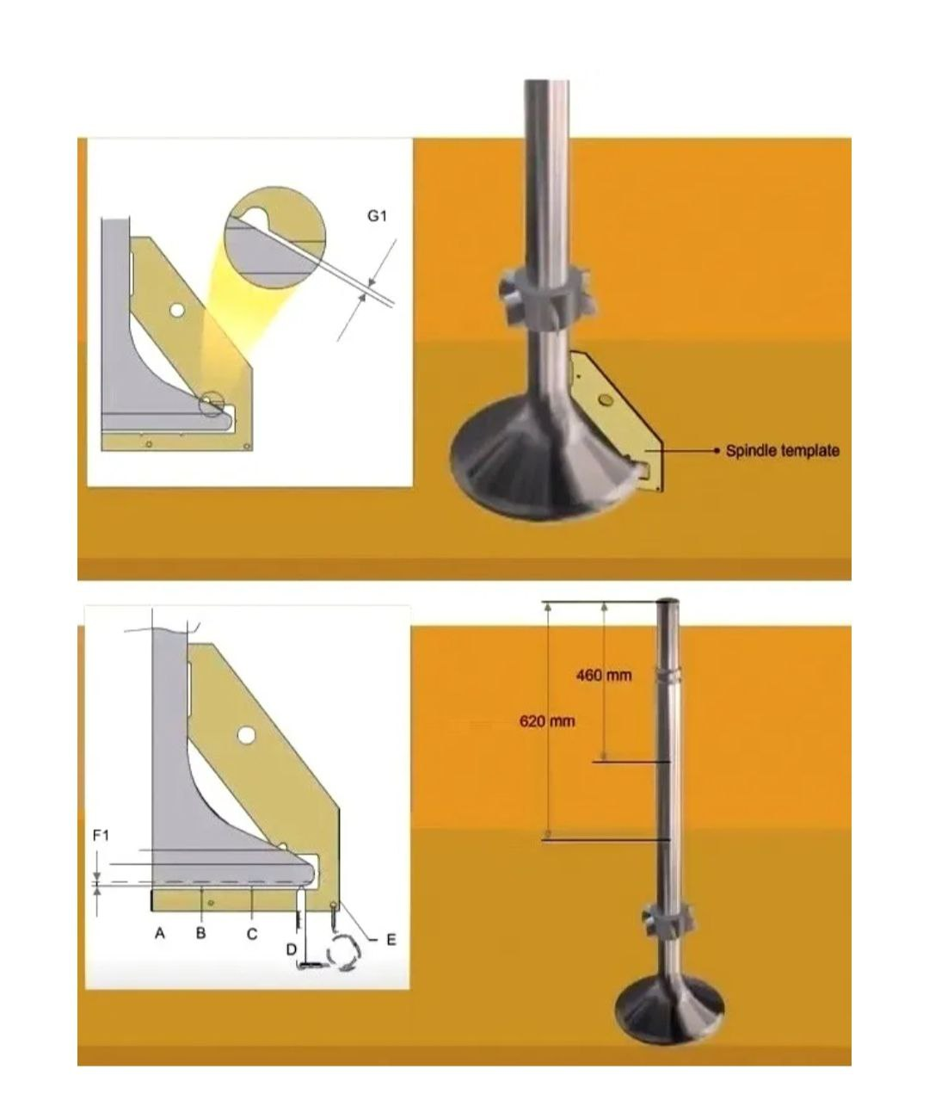

Slide 20
27. Check condition of thrust pads in the exhaust valve
28. Check the actuator for marks on the sealing surface
29. If the seating surface is too much worn they must be reconditioned by grinding.
30. Check the surface of hydraulic pipe connecting face for surface deformation, indicating leakage or incorrect tightness
31. Before fitting the exhaust valve back (or a new one), check the operation of “closing” by lifting the valve with engine room crane. Once it is clear off the ground, the valve will be in the open position. Connect air hose with compressed air supply to pneumatic piston inlet and open the air supply. This will close/ shut the valve.

Slide 21
32. Once the valve is closed, shut off the air supply and keep it in that position for 15 minutes and check that it does not open. This means that the air piston does not have leakage.
33. Open the vent plug screw located on the air cylinder- this will bring the valve in open condition.

Slide 22
3. VALVE GRINDING
For larger engines (2-stroke) the valve(s) can be ground. Valve grinding is not a difficult operation if certain precautions are taken.
Check if the seat is badly pitted or corroded, in which case no amount of grinding would help.
Another important precaution is to ensure that the valve stem is straight.
The valves should be ground with special machine tools and benches provided by the engine manufacturers.

Slide 23
Apply paste on the valves faces or cylinder head seats faces. Continue the valves grinding until you see a continuous foggy belt on the valve face and the valve seat face, not less than 1.5 mm wide. The belt breakings or scratches are not acceptable. Wash the head and the valves after grinding. When assembling the head apply motor oil on the valve stems.
Repeated grinding of a valve, without any control, is not a correct practice on account of two reasons. One, the valve-lid continues to get progressively thinner and thus it not only loses its inherent strength but the hard stellite coating (for exhaust valves in particular) on the valve lid will be abraded and this may lead to rapid failure of the valve. Besides, with uncontrolled grinding and thinning of the lid, and with the spindle having a fixed groove (around 75% up the spindle-end on top) for fitment of the cotters to secure the spindle in the spring-caps, there is a possibility that the sealing of the valve vis-à-vis the valve seat may be impaired.

